Slide 1

Acrogymnosperms
“Gymnosperms”
Judd et al pp. 216-232

Slide 2
“Gymnosperms”
Cycads (many nearing extinction)
Gingkos (one left-- Gingko biloba)
Conifers (have lost the chloroplast inverted repeat!)
Gnetales (have vessels like angiosperms, all other gymnosperms have only tracheids)
At least two extinct lineages that were polyphyletic with regards to currently extant “gymnosperms” (Acrogymnosperms)

Slide 3
Acrogymnosperms
Slow to reproduce– up to year between pollination and fertilization
Seed maturation takes up to 3 years
Except for Gnetales, only tracheids in xylem
Mostly wind pollinated
All are woody

Slide 4
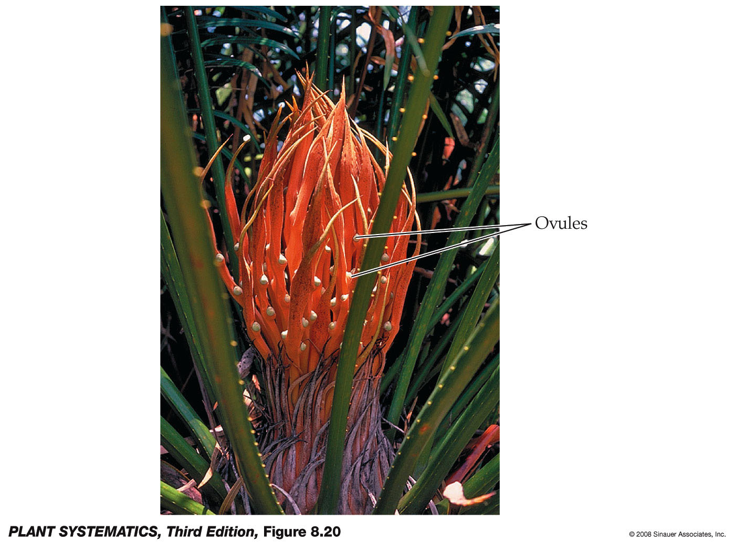
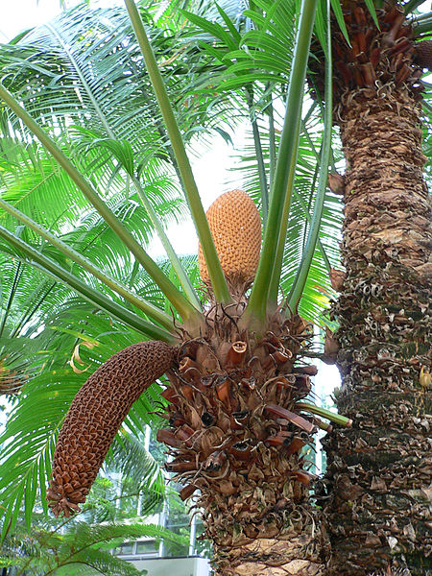
Cycads
An ancient group with primitive features, mostly southern hemisphere and endangered.
Male cones

Slide 5
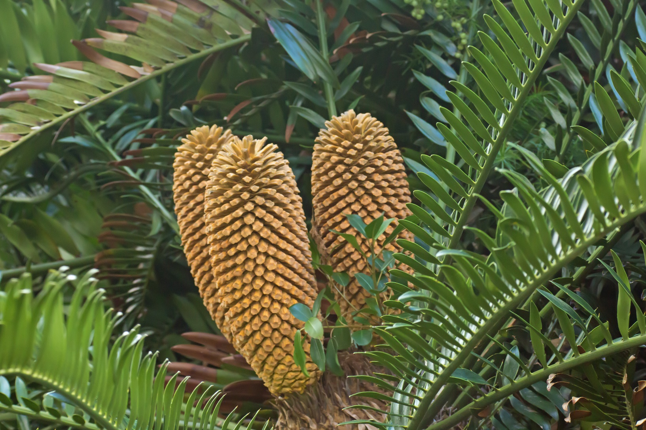
Cycad at Kirstenbosch Botanical Garden (male cones)

Slide 6
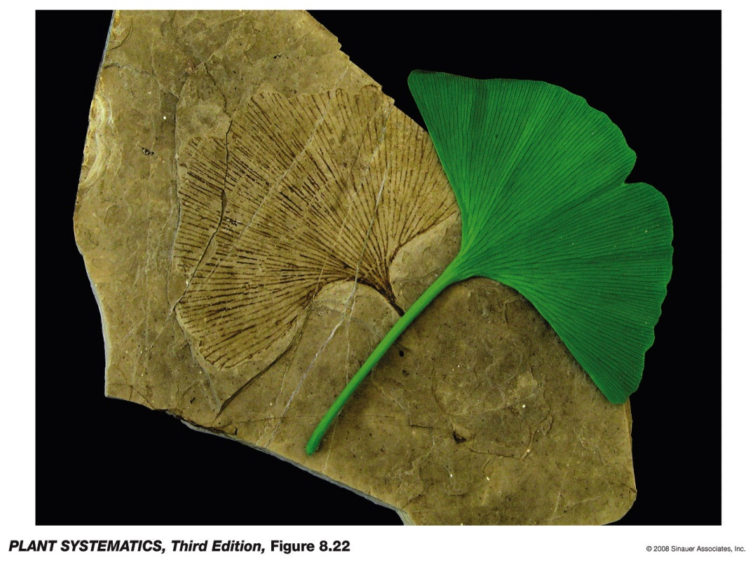
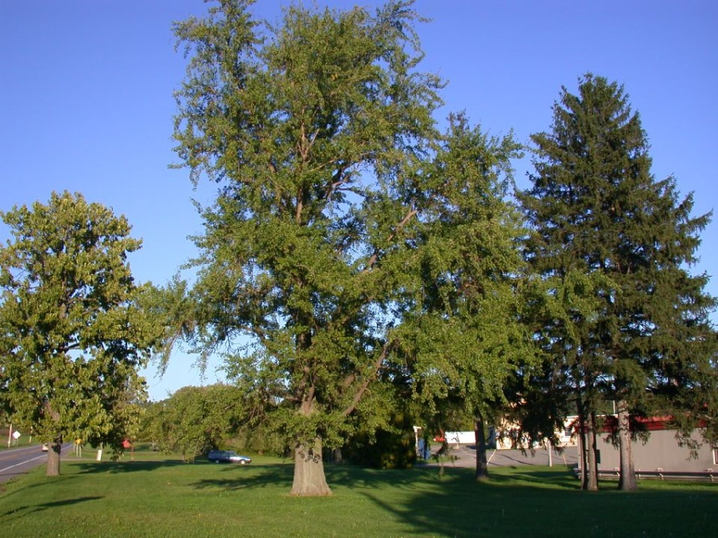
Ginkgoales
One member survives: Ginkgo biloba, all the rest extinct. They were widespread 120 MYBP.
Ginkgo biloba is possibly extinct in the wild, but used as ornamental because it does well as a shade tree in urban environments! One of the few plants with sex chromosomes.

Slide 7
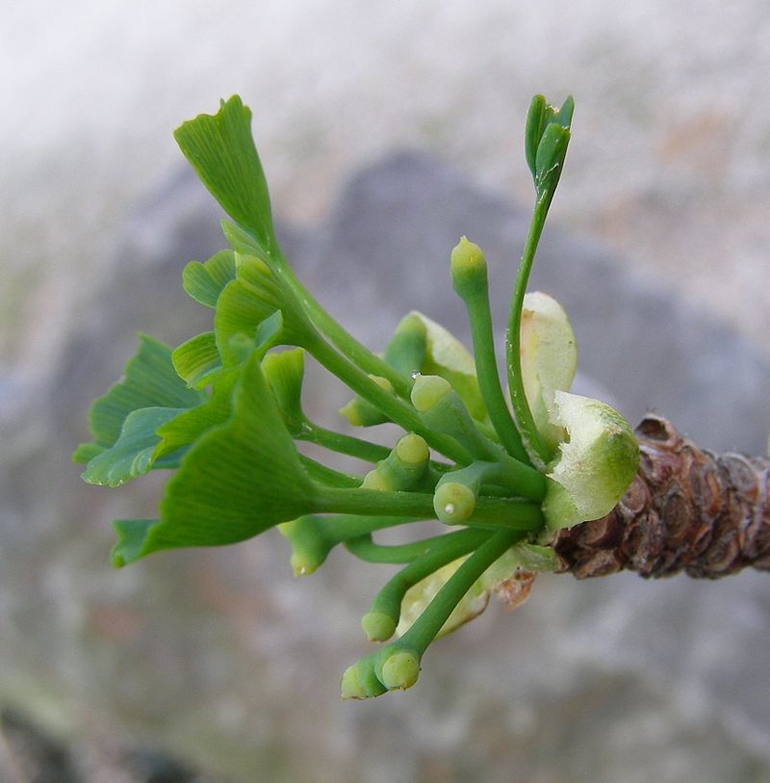
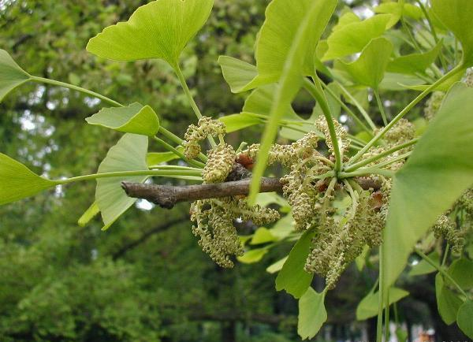
Ginkgo biloba-- dioecious
Ovulate plant
Staminate plant

Slide 8
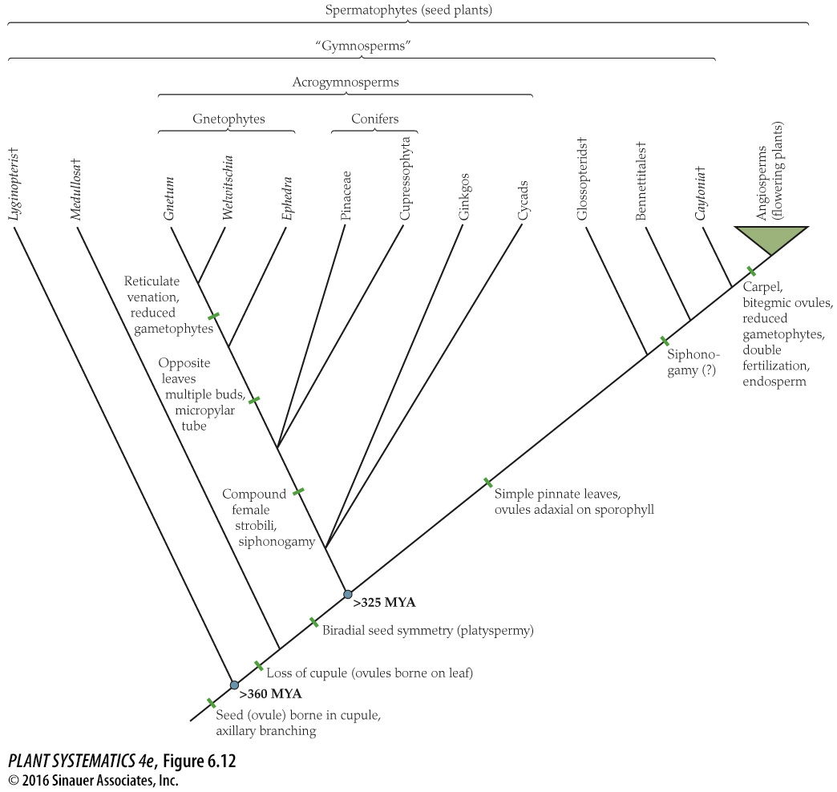
“Gymnosperms” are Polyphyletic, and a small part of the Spermatophytes (Seed Plants)
Angiosperms (except for Amborella) have vessels in the wood
Conifers in the Gila includes both the Pinaceae and the Cupressaceae (Junipers). Conifers have lost the chloroplast inverted repeat. Gnetophytes have the inverted repeat.
By far more angiosperms than gymnosperms extant today.

Slide 9
Acrogymnosperms
Needles (Pinaceae) are better adapted to drought than broad-leaved trees. (But not all Acrogymnosperms have needles, e.g. Gingko, Welwitschia).
Needles also cold hardy– above ground structures persist even in harsh environments
Evergreen habit has drawbacks– leaf death by disease, insects, etc., more damaging than for trees that produce new leaves each spring (But not all Acrogymnosperms are evergreen– e.g. Gingko)
Gametophytes much reduced compared to ferns

Slide 10
Acrogymnosperms
Swimming sperm (bryophytes, lycophytes, ferns) replaced by dispersal of the whole male gametophyte (pollen) except in Cycads and Gingko in which pollen is also dispersed but the sperm cells are still motile. Naked seeds develop on the surface of reproductive structures.
“Seed ferns” & “Gymnosperms” are first seed plants
Food storage tissue in seed is part of the female gametophyte= haploid tissue. Not the same as triploid endosperm that angiosperms have! (double fertilization in Gnetophytes does not lead to endosperm, but rather to a second embryo which is aborted)

Slide 11
Acrogymnosperms
All acrogymnosperms except the Gnetophytes have only tracheids in their xylem. Gnetophyte have features of both conifers (seeds not enclosed in an ovary) and angiosperms (vessels in the wood, somewhat flowerlike structures, & double fertilization, inverted repeat in chloroplast)
Conifers considered “softwood” while angiosperm trees are “hardwood”, has to do with whether vessel elements are present or not.

Slide 12
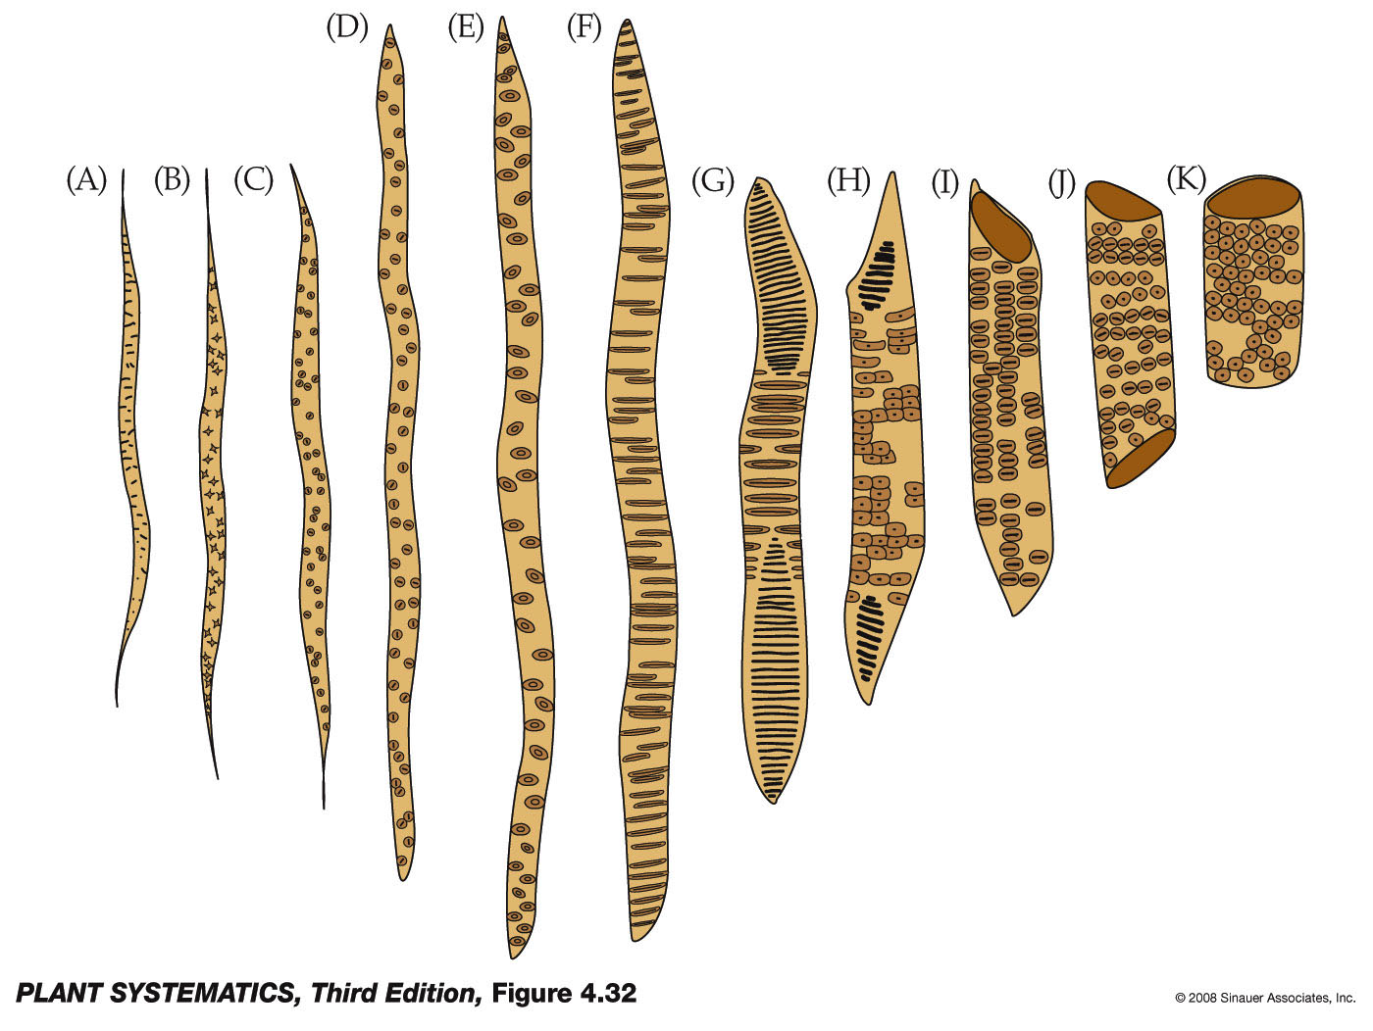
Xylem in Acrogymnosperms (except for Gnetophytes)

Slide 13
Xylem: Difference between tracheids and vessel elements
Vessel Elements (Angiosperms & Gnetophytes) | Tracheids (Lycophytes, Ferns, Acrogymnosperms except Gnetophytes)
Wide for better water transport | Narrow for better structural support
End plate missing or perforated | Ends are tapered and pitted
Dead at maturity | Dead at maturity
Absent in Acrogymnosperms except for Gnetophytes | Present in Acrogymnosperms

Slide 14
Gnetophytes
Ephedra trifurca
Welwitschia mirabilis
Very reduced leaves
Dioecious (separate male and female plants)
Ephedra-- Mostly desert species
Stems green
Very long lived– perhaps 1500-2000 years for oldest known specimens!
Only two leaves grow from the base and weather at the ends during entire life of plant
Stomata on top and bottom of leaves

Slide 15
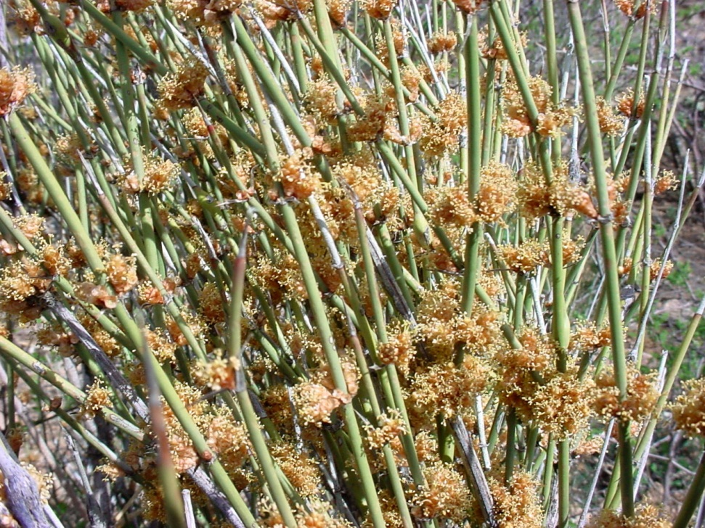
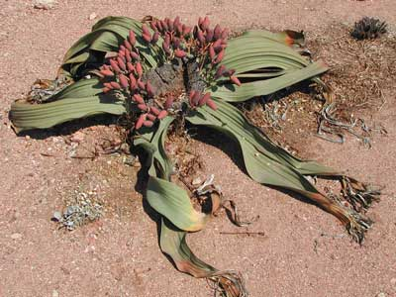
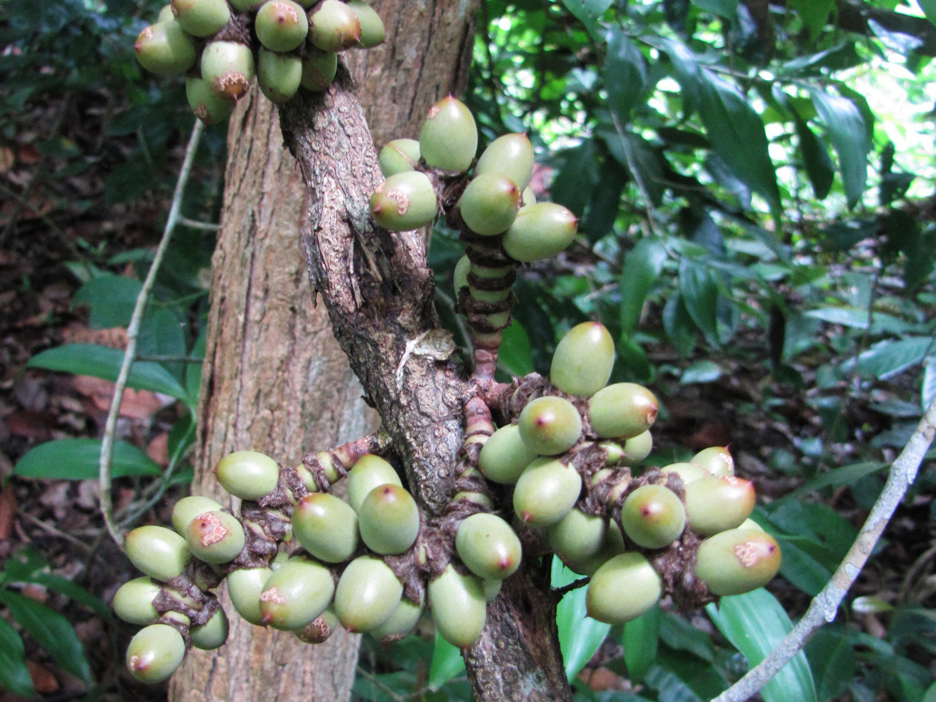
Gnetophytes
Ephedra trifurca
Welwitschia mirabilis
& Gnetum, a tropical genus with broad leaves

Slide 16
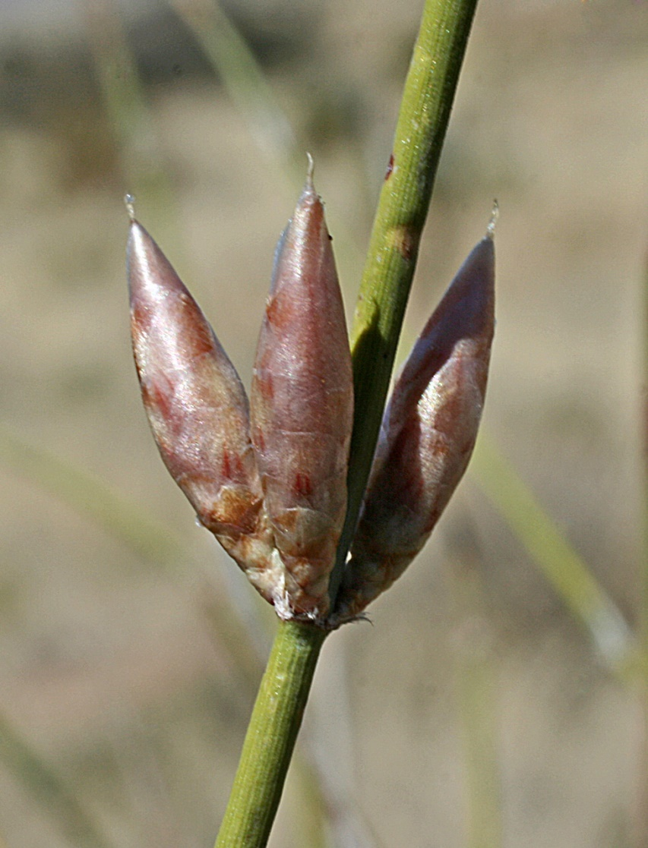
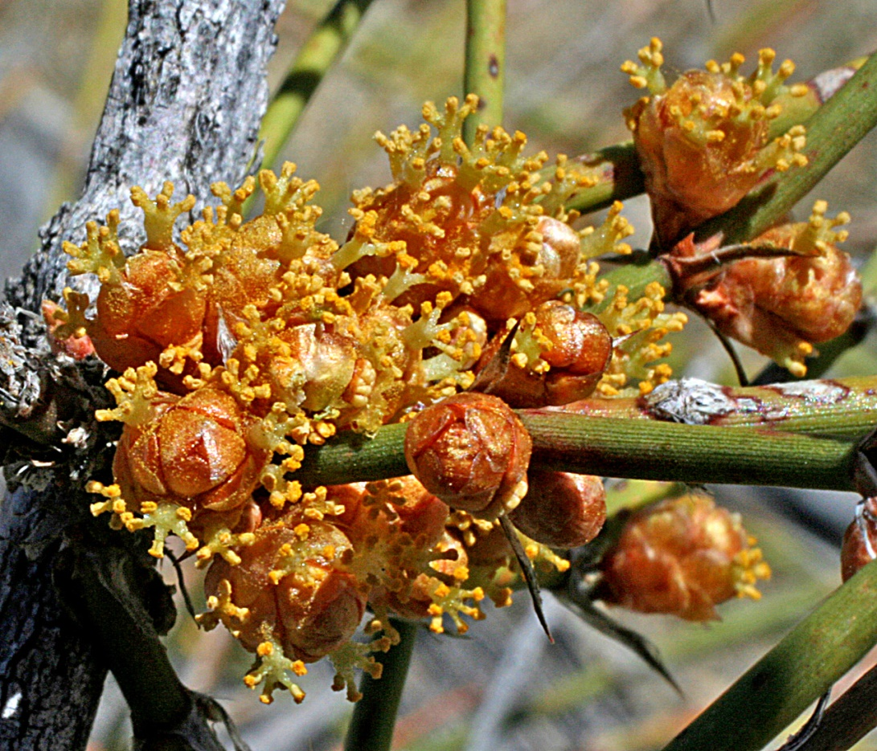
Gnetophytes– Ephedra trifurca
Male Cones
Female Cones

Slide 17
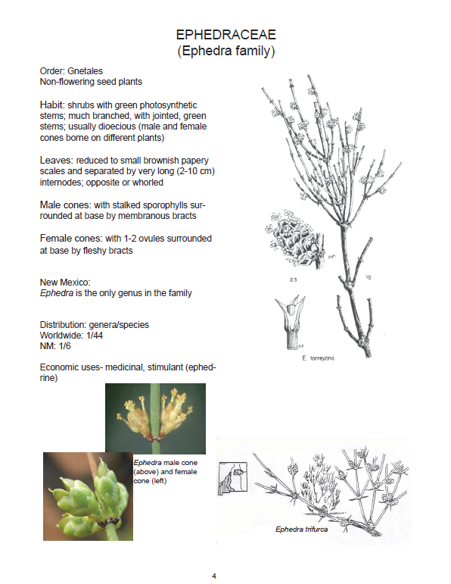
From the UNM Lab Manual by Jane Mygatt & Juliana Medeiros

Slide 18
Conifers (inverted repeat lost)-- Pinaceae
Generally two ovules per cone scale.
Inversion of the ovules, with the micropyle (passage through integuments for pollen tube to reach ovule) facing the axis of cone
Wing of seed derived from cone scale. Cone scales are modified short shoots and woody in the Pinaceae.
Scales are subtended by bracts.
Largest and most economically important group of gymnosperms (paper, building, ornamentals, etc).
Leaves needle like and sessile or fascicled.
Nearly all Northern Hemisphere (exception: Cedrus).

Slide 19
Conifers– Cupressaceae– only represented by Juniperus in the Gila
One to twenty ovules per cone scale, fusion of cone scale and bract.
Cone scales wholly adnate to bract and fleshy.
Cones are sometimes called “berry-like” but they are NOT berries.
Micropyle facing away from the cone axis. Leaves scale-like.

Slide 20
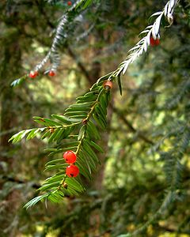
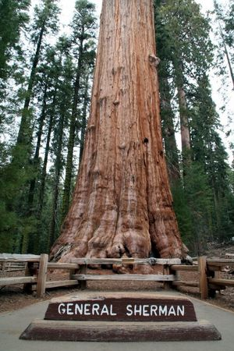
Conifers-- others
Elsewhere-- hemlocks, cedars, cypresses, redwoods, giant sequoias, yews, and others.
Giant sequoia– Sequoiadendron giganteum
Taxus brevifolia, Pacific Yew, the source of Taxol

Slide 21
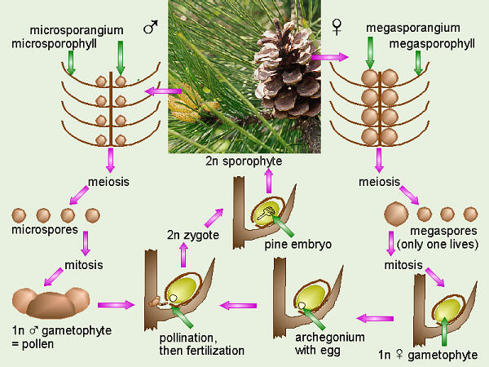
Conifer life cycle
Cone scale; they have omitted the subtending bract
Pine pollen has two air sacs for buoyancy in the wind (saccae)
Inverted ovule
Frequently a sticky droplet here to cause airborne pollen to adhere

Slide 22
Pinaceae in the Gila
Abies arizonica (Cork Bark Fir)
Abies concolor (White Fir)
Picea engelmannii var. engelmannii (Engelmann's Spruce)
Picea pungens (Blue Spruce)
Pinus cembroides var. bicolor (Mexican Pinon Pine)
Pinus edulis (Pinon Pine)
Pinus leiophylla var. chihuahuana (Chihuahua Pine)
Pinus monophylla (Arizona Single Leaf Pinon)
Pinus ponderosa var. arizonica (Arizona Pine)
Pinus ponderosa var. scopulorum (Ponderosa Pine)
Pinus strobiformis (Southwestern White Pine)
Pseudotsuga menziesii var. glauca (Douglas Fir)

Slide 23
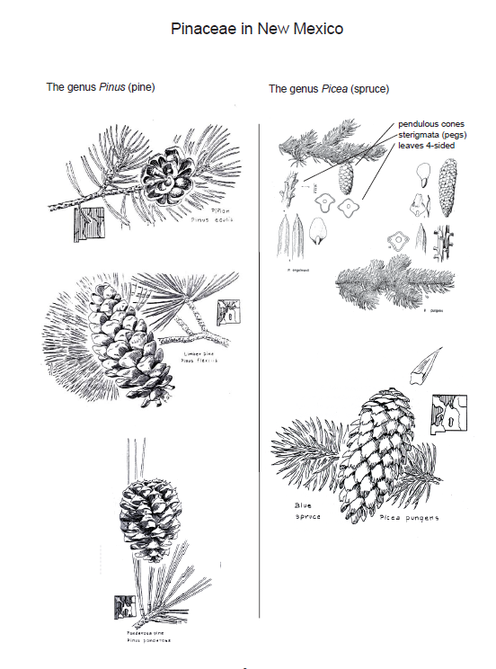
Fascicled needles; cone scales with either conspicuous or inconspicuous bracts
Picea has solitary needles on pegs.

Slide 24
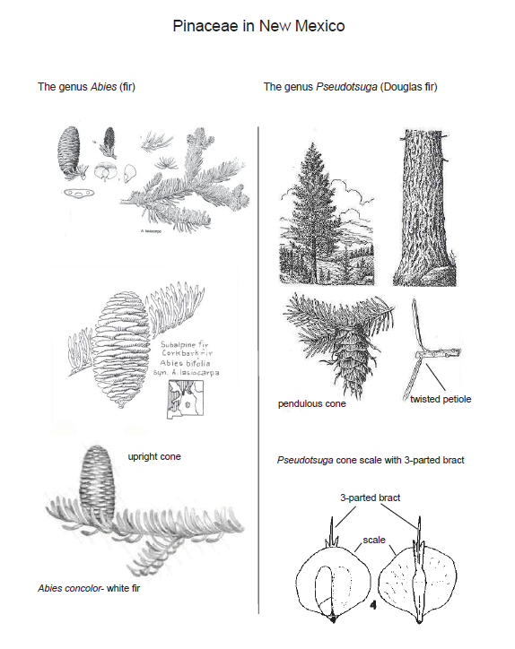
Abies has upright cones in top branches and needles that leave circular scars and not on pegs.
Twisted petiole gives impression that needles enter at 45 degree angle.

Slide 25
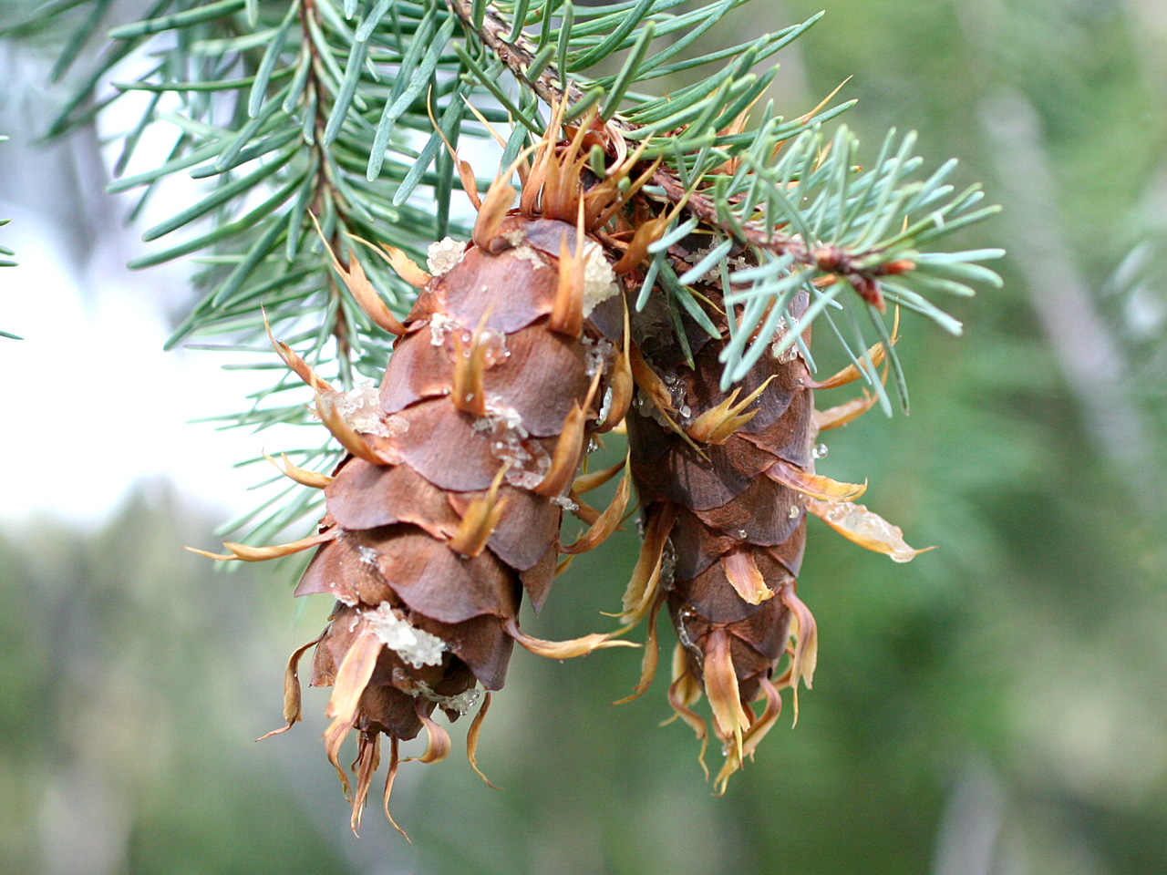
Pseudotsuga menziesii
Note long, three pointed bracts below the scales.

Slide 26
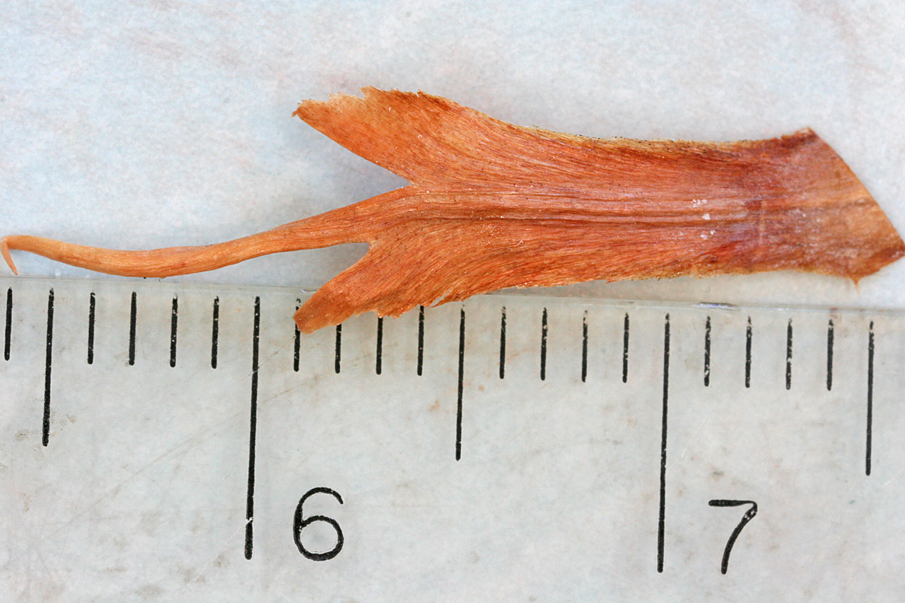
Pseudotsuga menziesii
Bracts in Pinaceae are free from the scale

Slide 27
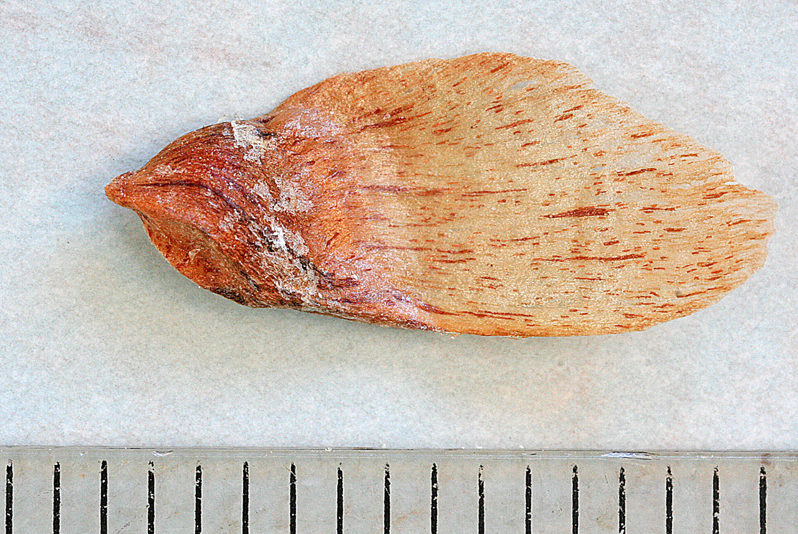
Pseudotsuga menziesii
The wing is derived from the cone scale.

Slide 28
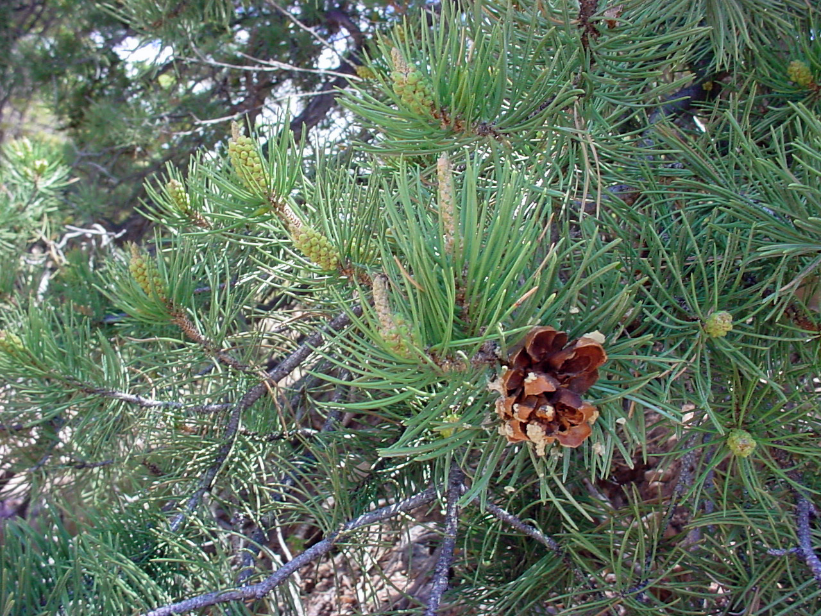
Pinus edulis
Male cones
Female cone
Pinaceae have both types of cones on same plant

Slide 29
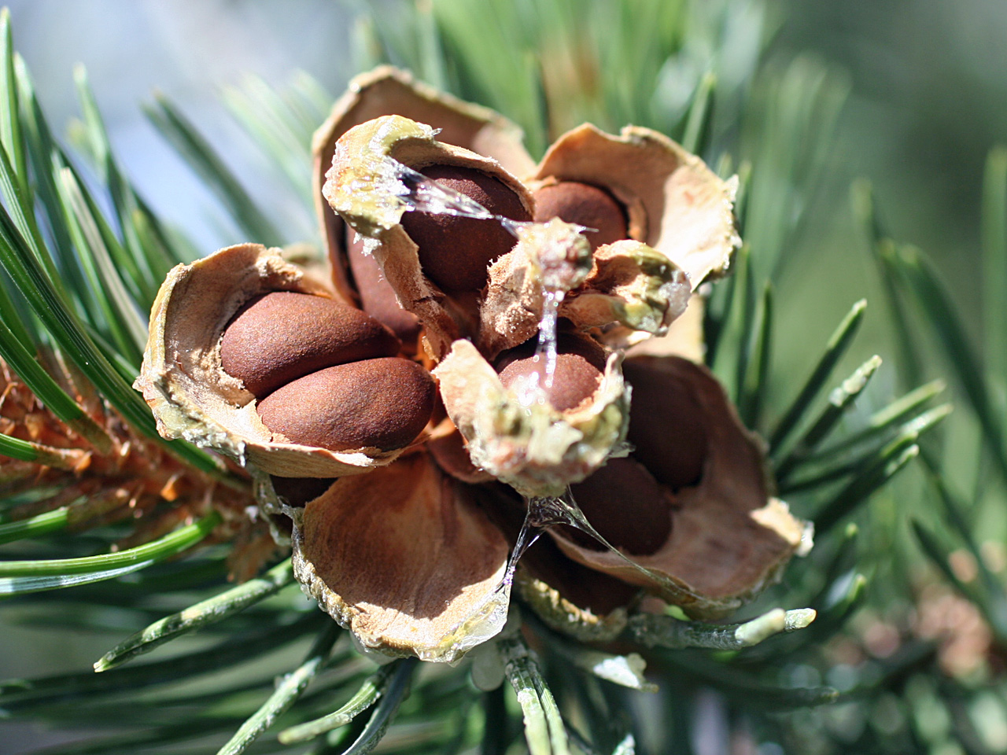
Pinus edulis
2 ovules per cone scale
No wings on Pinus edulis seeds

Slide 30
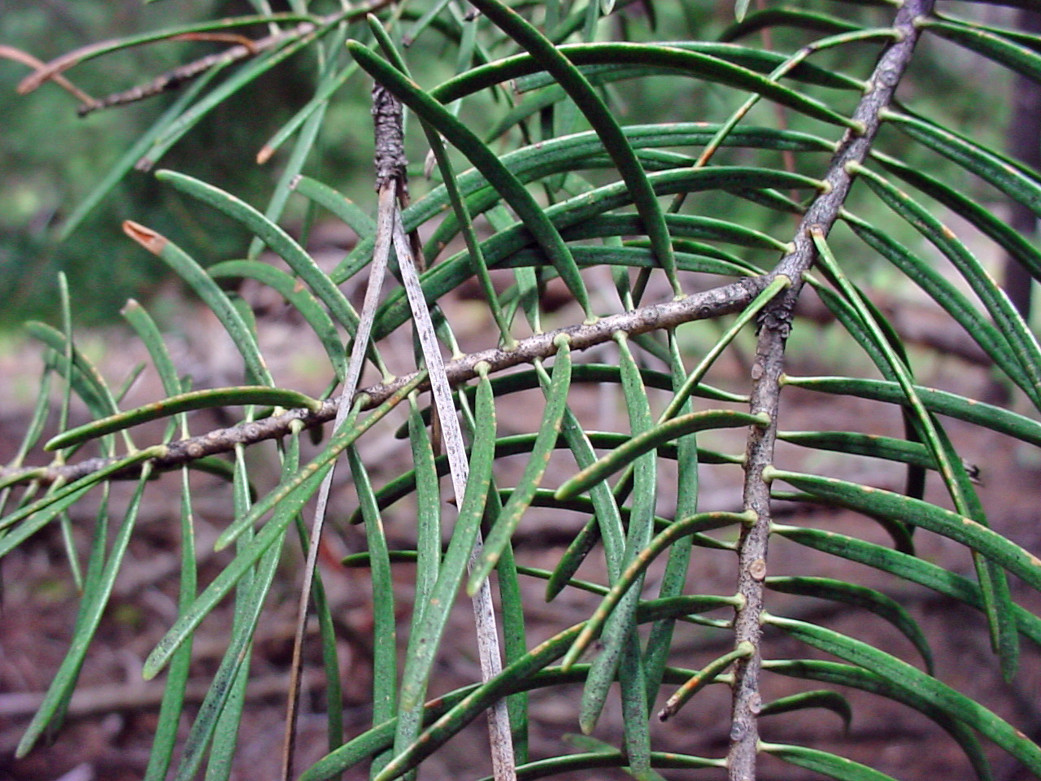
Abies concolor
Abies= round scars, not pegs as in Picea

Slide 31
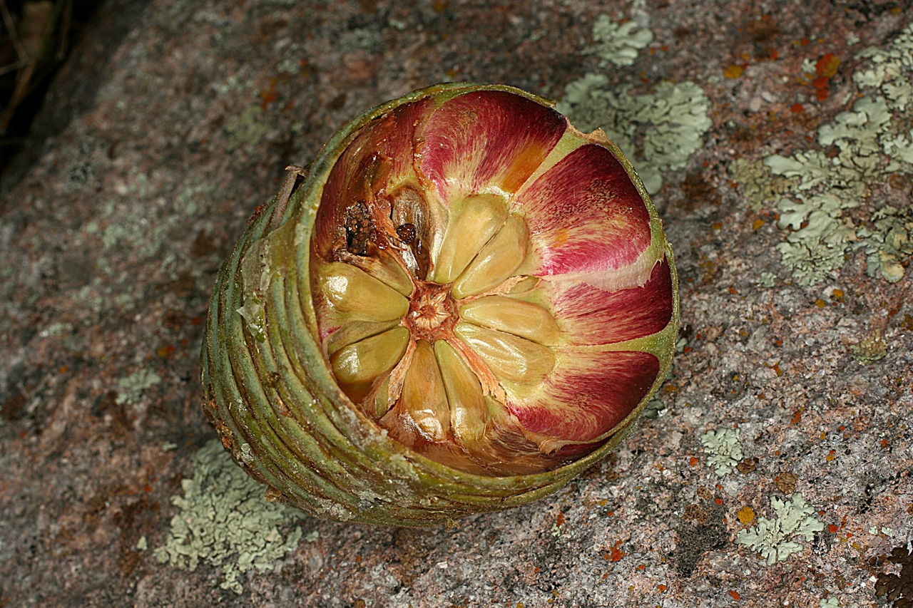
Abies concolor
2 ovules per scale, and wings derived from scale

Slide 32
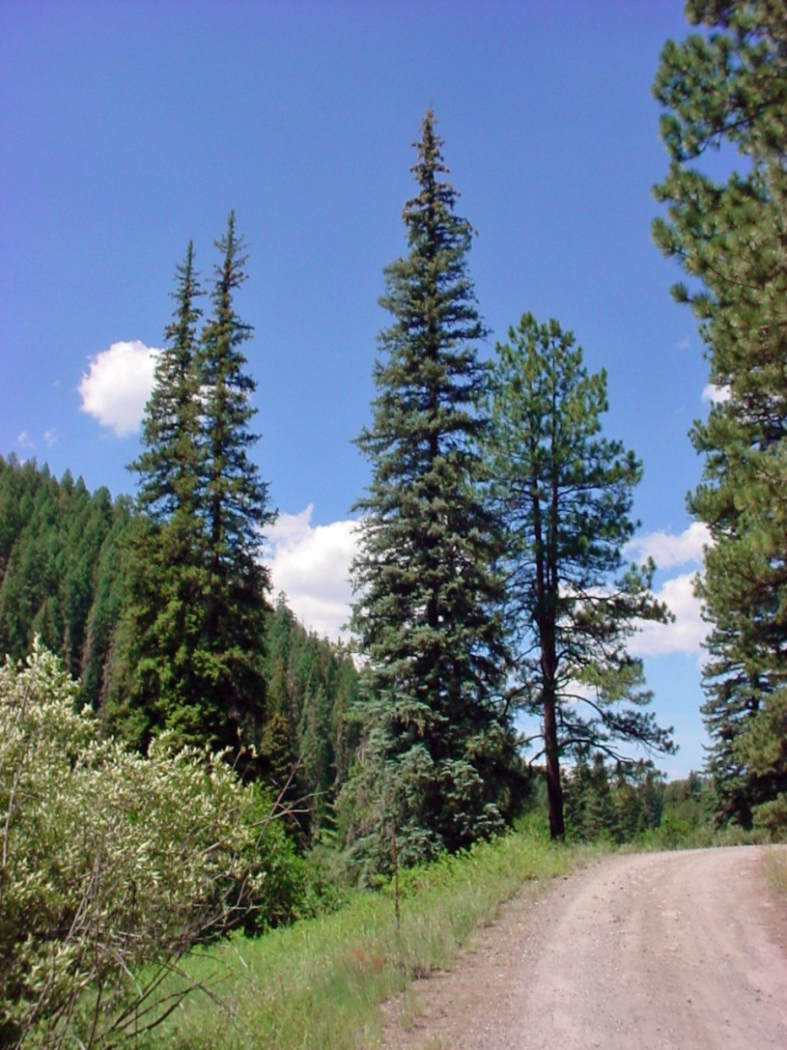
Picea pungens
Elongate shape

Slide 33
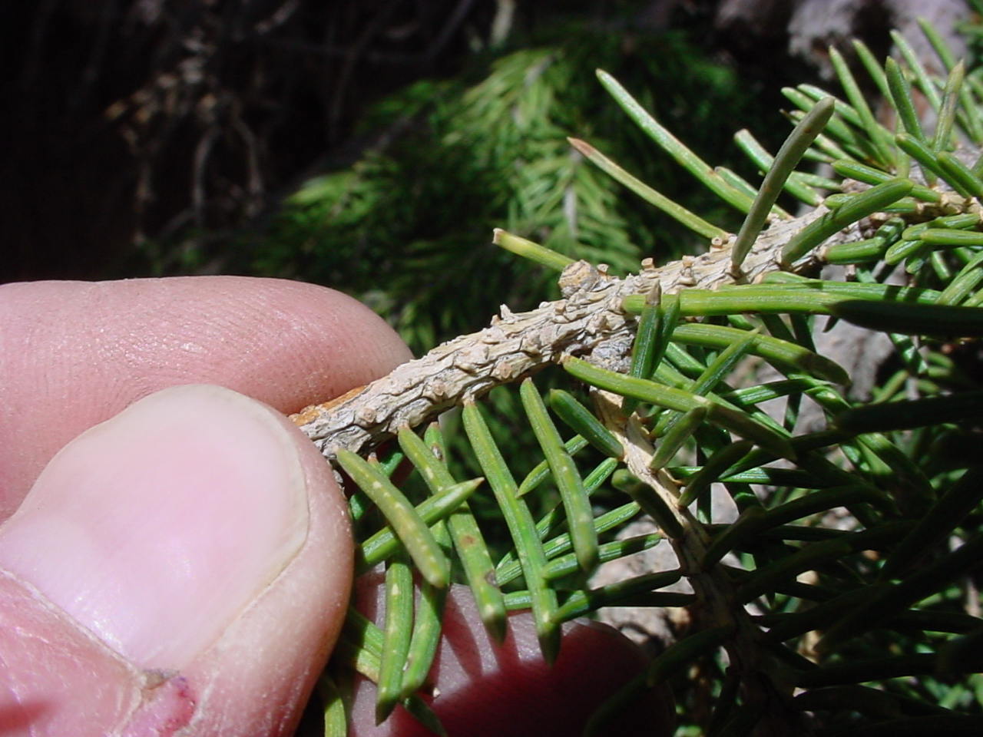
Picea pungens
Pegs/pedestals

Slide 34
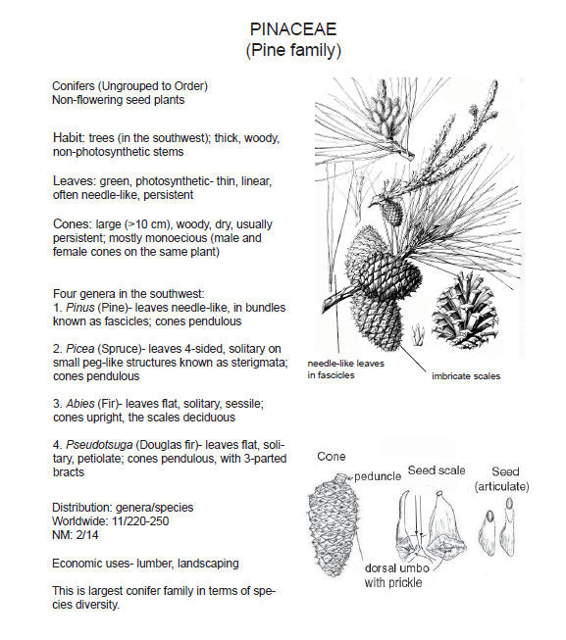

Slide 35
Cupressaceae in the Gila
Many species (but not all) of Juniperus are dioecious, remainder of the Cupressaceae are monoecious. Hard to remember since our common Juniperus are the dioecious Juniperus species.
Juniperus coahuilensis var. arizonica (Roseberry Juniper)
Juniperus communis var. depressa (Spreading Juniper)
Juniperus deppeana (Alligator Juniper)
Juniperus monosperma (One Seeded Juniper)
Juniperus osteosperma (Utah Juniper)
Juniperus scopulorum (Rocky Mountain Juniper)

Slide 36
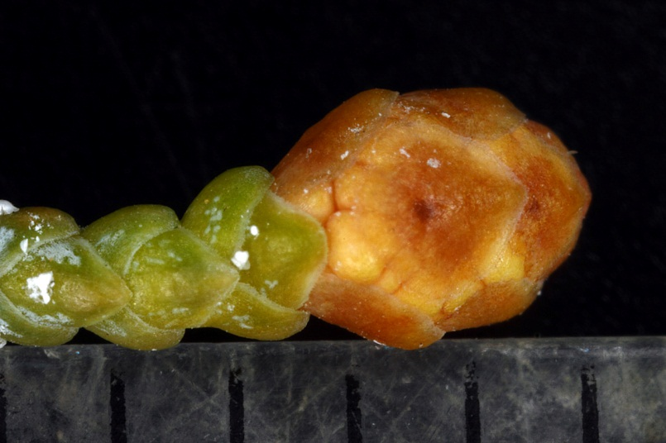
Juniperus deppeana
Pollen cone with pollen sacs

Slide 37
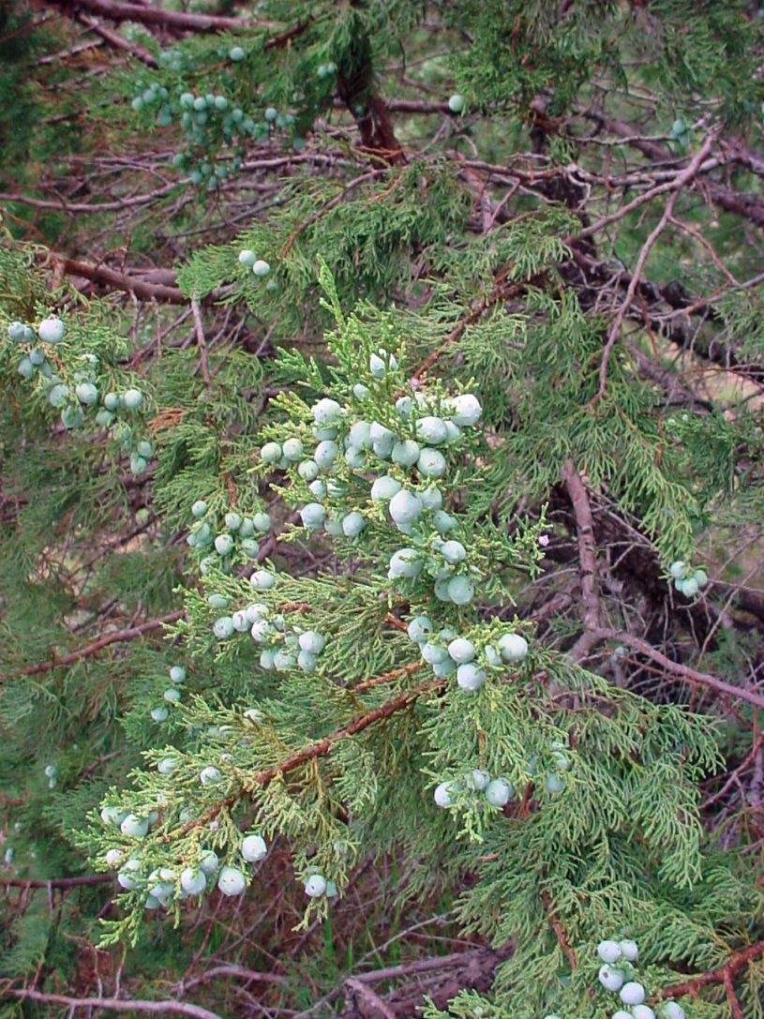
Juniperus deppeana
Ovulate cones

Slide 38
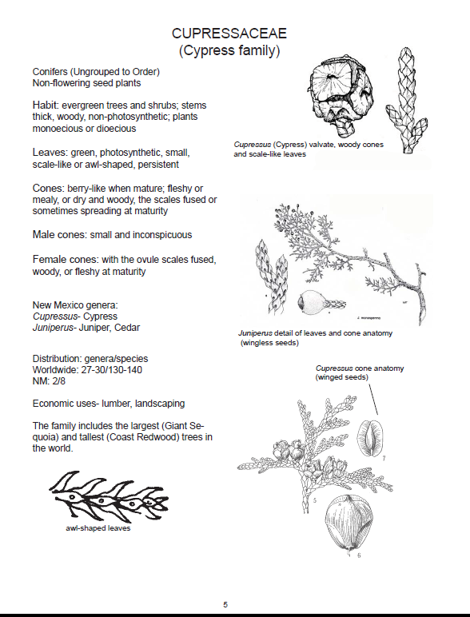
From the UNM Lab Manual by Jane Mygatt & Juliana Medeiros

Slide 39
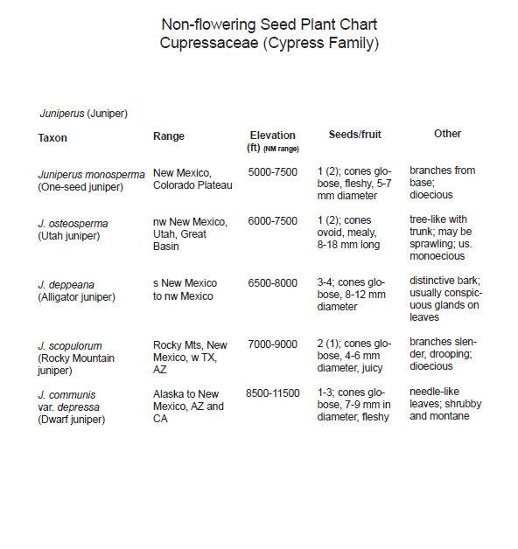
From the UNM Lab Manual by Jane Mygatt & Juliana Medeiros

